Slide 1


Ajibose G Okanlawon
21/03/2023

Slide 2

Outline
Executive Summary
Introduction
Methodology
Results
Conclusion
Appendix

Slide 3
Executive Summary
We will forecast whether the SpaceX Falcon 9 first stage will successfully land in this capstone assignment. The price of a launch can be calculated if we can know if the first stage will land.
Several machine learning classification techniques will be used to achieve this, Data collection, data wrangling and preprocessing, exploratory data analysis, data visualisation, and machine learning prediction will all be included in the methodology.
The findings of our inquiry and analysis suggest that there are specific characteristics of rocket launches that are correlated with successful or unsuccessful launches.
Hence, we draw the conclusion that the Decision Tree may be the most effective machine learning approach for this issue.

Slide 4
Introduction
This capstone project's major objective is to foretell if the Falcon 9 first stage will successfully land. SpaceX advertises on their website that their rocket launches cost 62 million while other providers charge upwards of 165 million because they take great pride in being able to reuse the first stage of a rocket launch. The reuse of the first stage is largely responsible for these cost savings. The price of a launch can be calculated if we can know if the first stage will land. If a different business want to compete with SpaceX for a rocket launch, it may use the information provided here.
This gets us to the key inquiry we are attempting to address: Under the specified conditions of a Falcon 9 rocket launch, will the rocket's first stage successfully land or not?

Slide 5

Section 1

Slide 6
Methodology
Executive Summary
Data was gathered using two techniques: web scraping launch information from a Wikipedia article and requesting information from the SpaceX API. The data was then transformed and cleaned using the pandas module in Python.
Exploratory data analysis (EDA) was done on the clean data utilising visualisation tools including Python's matplotlib and seaborn packages, as well as SQL queries to provide answers. In order to respond to some analytical queries, interactive visualisation packages in Python were employed. Maps were produced using Folium, and interactive data visualisations with Plotly Dash.
For the prediction study, four alternative machine learning classification models were employed. Support vector machines, logistic regression, k-nearest neighbour, and decision tree classifier are the models that were applied. Each model was trained and evaluated.

Slide 7
Data Collection- Using SpaceX API
Request and parse the SpaceX launch data using the GET request
GitHub Link: Data Collection-Using SpaceX API
Normalize JSON response into a data frame
Extract only useful columns using auxiliary functions
Create new pandas data frame from dictionary
Filter Data frame to only include Falcon 9 launches
Handle missing values or Nan values
Export to CSV file

Slide 8
Data Collection- Using Web Scraping
Request rocket launch data from its Wikipedia page
GitHub Link: Data Collection-Using Web Scraping
Extract all column/variable names from the HTML table header
Create a data frame by parsing the launch HTML tables
Export to CSV file

Slide 9
Data Wrangling
Calculate the number of launches on each site
GitHub Link: Data Wrangling
Calculate the number and occurrence of each orbit
Calculate the number and occurence of mission outcome per orbit type
Create a landing outcome label from Outcome column using one-hot encoding
Export to CSV

Slide 10
EDA with Data Visualization
The link between two variables was represented using scatter plots. varying sets of features The link between two variables was represented using scatter plots. As examples of comparisons, Flight Number vs. Launch Site, Payload vs. Launch Site, Flight Number vs. Orbit Type, and Payload vs. Orbit Type were made.
Bar chart: The usage of bar charts allows for quick comparison of values between various groups. The y-axis indicates a discrete number, while the x-axis represents a category. The Success Rate for various Orbit Types was compared using bar charts.
Line graphs are useful for displaying data trends across time. The Success Rate over several years was displayed using a line chart.
GitHub Link: EDA with Data Visualization

Slide 11
EDA with SQL
The following is a list of some of the SQL queries that were run on the dataset:
Displaying the names of the distinct launch sites used in the space mission; Displaying 5 records where the first letter of the launch site is "CCA“; Displaying the total mass of payloads carried by NASA-launched boosters (CRS); Displaying the average mass of payloads carried by booster version F9 v1.1.
The names of the boosters that have succeeded in drone ships and have payload masses greater than 4000 but less than 6000; the total number of successful and unsuccessful mission outcomes; the names of the booster versions that have carried the maximum payload mass; the date when the first successful landing outcome in a ground pad was achieved; a list of some of the SQL operations made on the database Listing the drone ship unsuccessful landing outcomes for the year 2015, their booster versions, and launch locations —- Ranking the number of landing outcomes between 2010-06-04 and 2017-03-20, from most to least successful.
GitHub Link: EDA with SQL

Slide 12
Build an Interactive Map with Folium
The creation and addition of objects to a Folium map. All launch sites, as well as the successful and unsuccessful launches for each site, were displayed on a map using marker objects. The distances between a launch location and its environs were calculated using line objects.
The following geographic patterns about launch places are discovered by including these objects:
The train lines close to the launch sites.
The motorways are nearby the launch sites
Launch sites are near to a shore
Launch sites maintain a specific distance from cities
GitHub Link: Building an Interactive Map with Folium

Slide 13
Build a Dashboard with Plotly Dash
Two graphs are included in the dashboard application:
A pie chart displaying each site's successful launch. This graph is helpful since it allows you to display the success rate of launches on specific sites or visualise the distribution of landing outcomes across all launch locations.
A scatter diagram illustrating the relationship between landing success and the mass of various boosters. The site(s) and payload mass are the dashboard's two inputs. This chart is helpful since it allows you to see how different factors influence the results of the landing.
GitHub Link: Building a Dashboard with Plotly Dash

Slide 14
Predictive Analysis (Classification)
Create column for “Class”
Standardizing the data
Split into training and test set
Find best Hyperparameter for SVM, Decision Trees, K-Nearest Neighbours and Logistic Regression.
Use test data to evaluate models based on their accuracy scores and confusion matrix
GitHub Link: Space-X Machine Learning Prediction

Slide 15
Results
The outcomes of the exploratory data analysis showed that 66.66% of Falcon 9 landing attempts were successful.
The Decision Tree algorithm was the best classification technique, with a 94% accuracy rate, according to the results of the predictive study.

Slide 16

Section 2

Slide 17
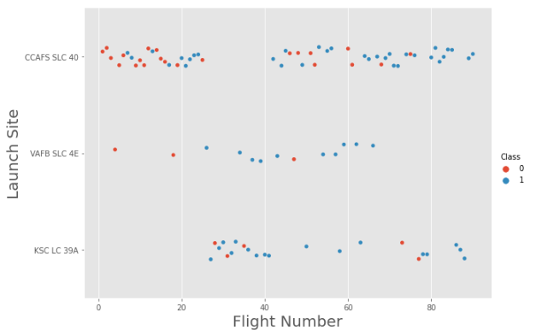
Flight Number vs. Launch Site
The exploratory data analysis findings showed by the graph demonstrates that as the number of flights increased, so did the success rate.
The successful launches are shown by blue dots, whereas the failed launches are represented by red dots.
After the 40th launch, there seems to be an uptick in successful flights.

Slide 18
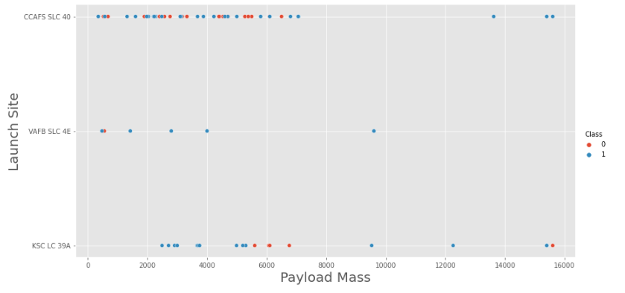
Payload vs. Launch Site
According to the findings of the exploratory data analysis, successful launches are represented by blue dots, whereas failure launches are represented by red dots.
There are no rockets launched for heavy payload mass from the VAFB-SLC launch site.
Decisions cannot be made using this metric because there appears to be a poor association between Payload and Launch Location.

Slide 19
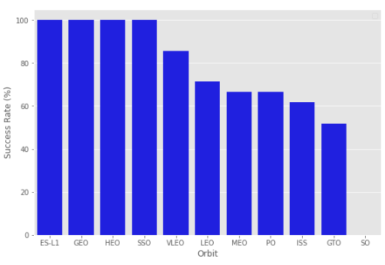
Success Rate vs. Orbit Type
The findings of the exploratory data analysis showed that the success rates for the Orbits SSO, HEO, GEO, and ES-L1 are all 100%. The findings of the exploratory data analysis showed that the success rates for the Orbits SSO, HEO, GEO, and ES-L1 are all 100%.
With a 0% success rate, SO orbit had no launches that were successful.

Slide 20
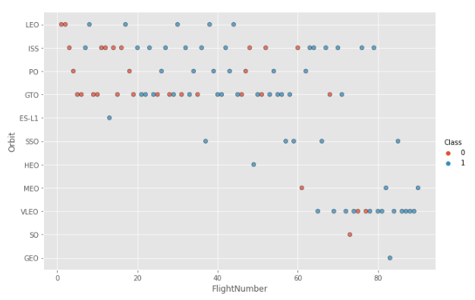
Flight Number vs. Orbit Type
The number of trips is strongly connected with success in the LEO orbit.
In the GTO orbit, there does not appear to be a correlation between flight numbers.
The SSO orbit has fewer flights than the other orbits but a success record of 100%
.The success rate of flights with numbers over 40 is higher than that of flights with numbers between 0 and 40.

Slide 21
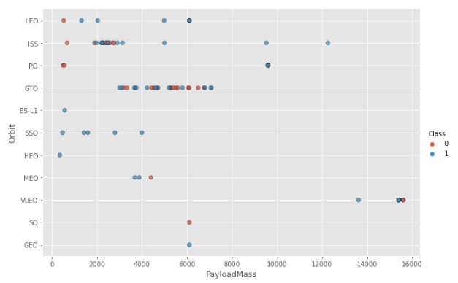
Payload vs. Orbit Type
The success rate rises in the PO, SSO, LEO, and ISS orbits as payload weight increases.
While both successful and unsuccessful launches are frequently observed, there does not appear to be a direct association between orbit type and payload mass for GTO orbit.

Slide 22
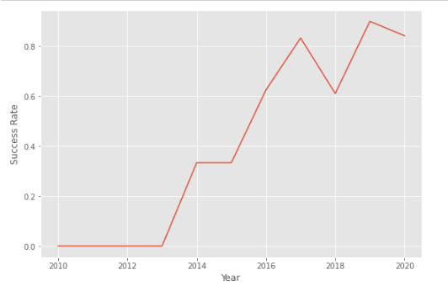
Launch Success Yearly Trend
There seems to be a sharp increase in success rate from 0% from 2013.
The general trend of the chart shows an increase in landing success rate as the years pass. There is however a dip in 2018 as well as in 2020.

Slide 23
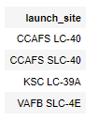
All Launch Site Names
The DISTINCT clause was used to return only the unique rows from the launch_site column.
The names of the launch sites are CCAFS LC-40, CCAFS SLC-40, KSC LC-39A, VAFB SLC-4E .

Slide 24
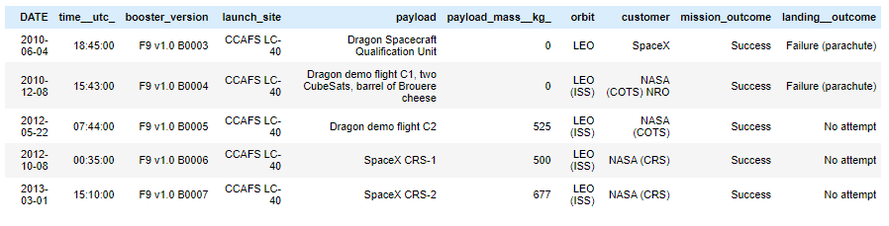
Launch Site Names Begin with 'CCA'
The LIMIT and LIKE clauses were used to display only the top five results where the launch_site name starts with 'CCA'

Slide 25
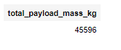
Total Payload Mass
The SUM() function was used to the calculate the total payload carried by boosters from NASA from the payload_mass__kg column.

Slide 26
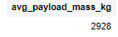
Average Payload Mass by F9 v1.1
The AVG() function was used to the calculate the average payload the average payload mass carried by booster version F9 v1.1
The WHERE clause was used to filter results so that the calculations were only performed on booster_versions only if they were named “F9 v1.1”

Slide 27
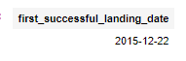
First Successful Ground Landing Date
The MIN(DATE) function was used to find the date of the first successful landing outcome on ground pad
The WHERE clause ensured that the results were filtered to match only when the 'landing_outcome' column is 'Success (ground pad)'

Slide 28
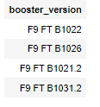
Successful Drone Ship Landing with Payload between 4000 and 6000
The BETWEEN clause was used to retrieve only those results of payload mass greater than 4000 but less than 6000. The WHERE clause filtered the results to include only boosters which successfully landed on drone ship.

Slide 29
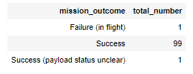
Total Number of Successful and Failure Mission Outcomes
The COUNT() function is used to count the number of occurences of different mission outcomes with the help of the GROUPBY clause applied to the 'mission_outcome' column. A list of the total number of successful and failure mission outcomes was returned.
There have been 99 successful mission outcomes out of 101 missions.

Slide 30
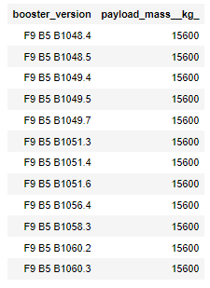
Boosters Carried Maximum Payload
The MAX() function was used in a subquery to retrieve a list of boosters which have carried the maximum payload mass.

Slide 31
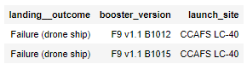
2015 Launch Records
The SELECT statement was used to retrieve multiple columns from the table. The YEAR(DATE) function was used to retrieve only those rows with a 2015 launch date.

Slide 32
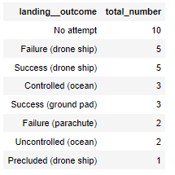
Rank Landing Outcomes Between 2010-06-04 and 2017-03-20
COUNT() function was used to count the different landing outcomes.'The WHERE and BETWEEN clauses filtered the results to only include results between 2010-06-04 and 2017-03-20. The GROUPBY clause ensure that the counts were grouped by their outcome. The ORDERBY and DESC clauses were used to sort the results by descending order.

Slide 33

Section 3

Slide 34
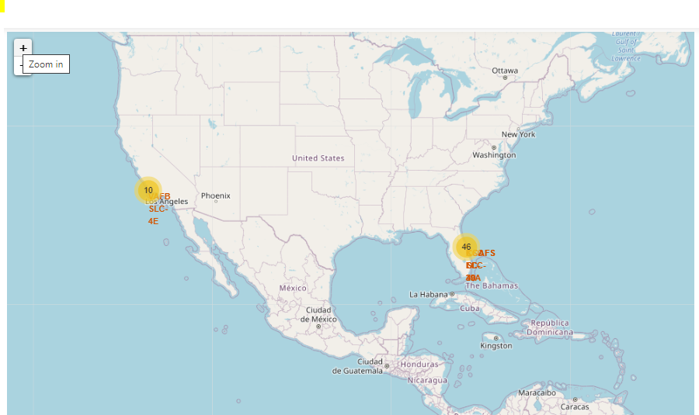
SpaceX Launch Sites Locations
The locations of all the SpaceX launch sites in the US are indicated by the yellow markers.
The launch pads have been situated in a suitable location close to the coast.

Slide 35
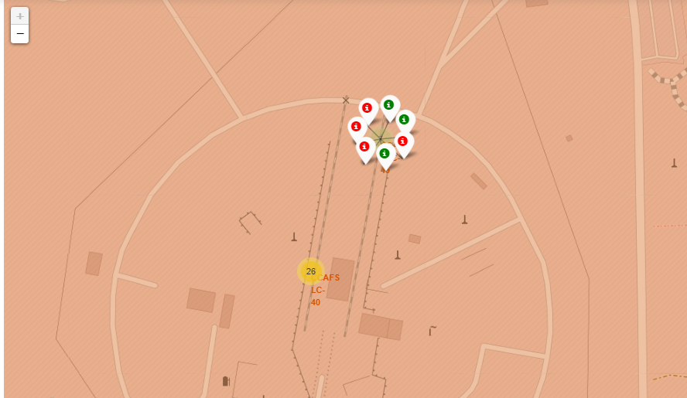
Success and Failure on Launch Site
The launch site will show marker clusters of successful landings (green) or failed landings as we zoom in on a launch location (red).

Slide 36
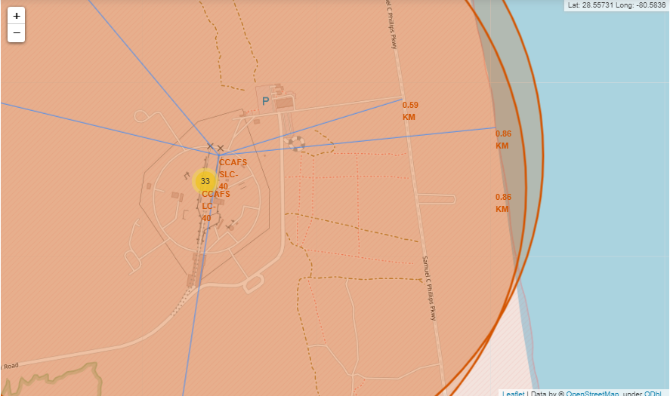
Launch Site Proximities To Resources
The generated map reveals that the chosen launch point is close to a highway for people and equipment transportation.
For launch failure testing, the launch site is also close to the coast.
Also, the launch locations keep a specific distance from the cities.

Slide 37

Section 4

Slide 38
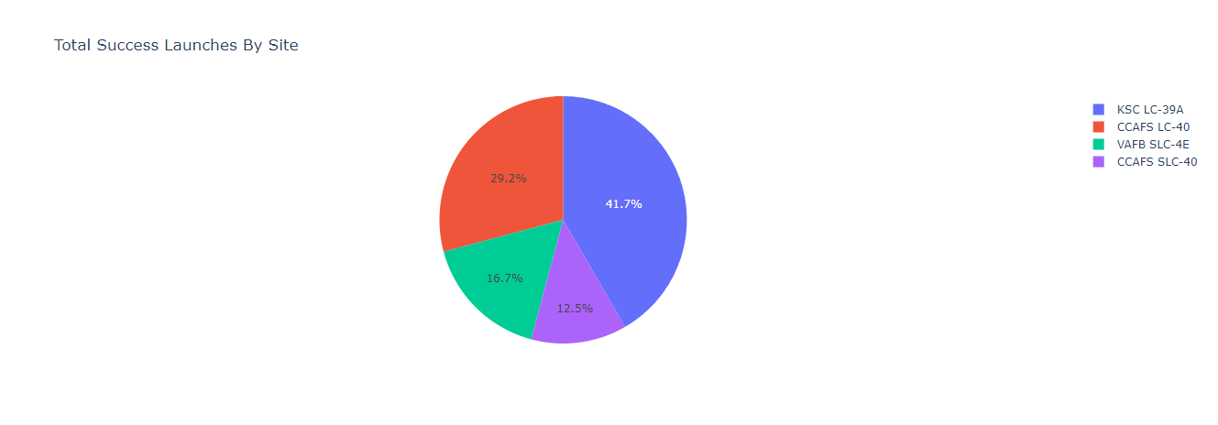
Total Successful Launches By Site
With a total of 10, the KSC LC-39A Launch site has had the most successful launches.

Slide 39
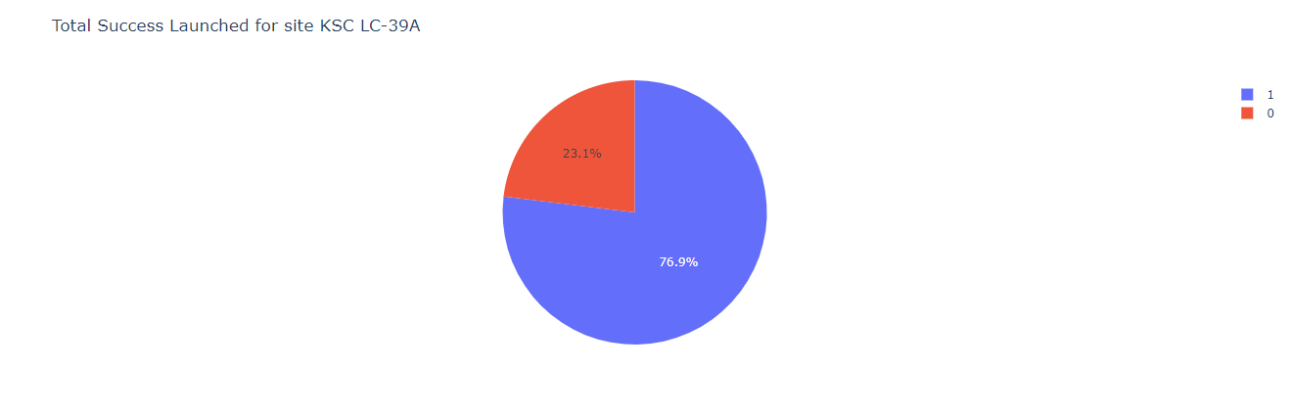
Launch Site With Highest Success Ratio
With a success rate of 76.9%, the KSLC-39A leads the pack.

Slide 40
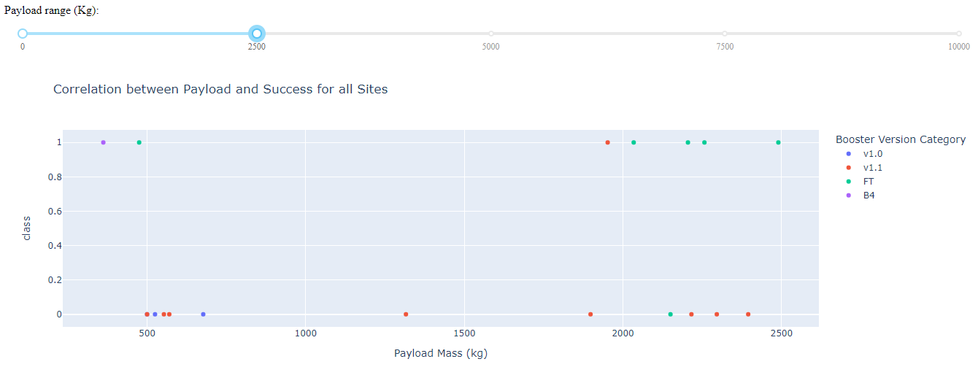
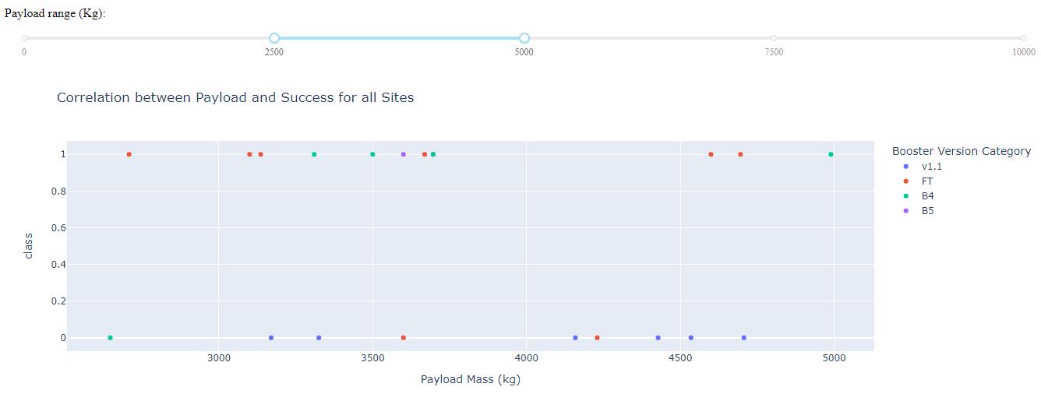
Payloads vs Launch Outcome
Payloads between 0 and 2500 kg have a somewhat lower launch success percentage than payloads between 250 and 5000 kg. Really, there isn't much of a distinction between the two.
In both weight ranges, the v1.1 booster version had the highest effectiveness rate.

Slide 41

Section 5

Slide 42
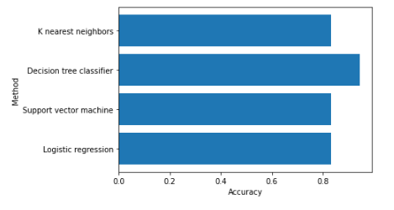
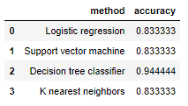
Classification Accuracy
The Decision tree classifier had the best accuracy at 94%.

Slide 43

Confusion Matrix
When the True label was success (True Positive), the model predicted 12 successful landings, and when it was failure, it predicted 3 unsuccessful landings (True Negative).
When the True label was an unsuccessful landing, the algorithm also predicted three successful landings (False Positive).
Successful landings were frequently predicted by the model.

Slide 44
Conclusions
The analysis revealed that as the success rate has increased over time, there is a positive correlation between the number of flights and success rate.
The most successful launches occurred in orbits like SSO, HEO, GEO, and ES-L1.Payload mass can be related to success rate since lighter payloads have typically had better results than bigger payloads.
The launch sites are placed in a safe distance from cities but strategically close to roads and railroads for the transit of people and goods.
The Decision Tree Classifier is the most accurate predictive model for this dataset, having a 94% accuracy rate.

Slide 45
Appendix
Coursera Project Link: https://www.coursera.org/learn/applied-data-science-capstone/home/welcome
GitHub Repository: https://github.com/Ajay0-data/IBM-Data-Science-Capstone-Project

Slide 46


